Slide 1
Compiling Principles & Compiler Construction
Zhai Yuqing,Zhang Zhizheng
yqzhai@seu.edu.cn
seu_zzz@seu.edu.cn
Zhai Yuqing:13951756001
QQ:1635967304
Course QQ:692354464
编译原理2019

Slide 2


Slide 3
Main References
√1、Compilers:Principles,Techniques,and Tools(2nd Edition),A.V Aho,Ravi Sethi, J.D Ullman,机械工业出版社，2011
2、Modern Compiler Implementation in C, Andrew W Appeal，人民邮电出版社，2005
3、Modern Compiler Implementation in Java,Andrew W Appeal，高等教育出版社，2003
4、编译原理及编译程序构造，秦振松，东南大学出版社,1997
5、程序设计语言编译原理，陈火旺，国防工业出版社,2000

Slide 4
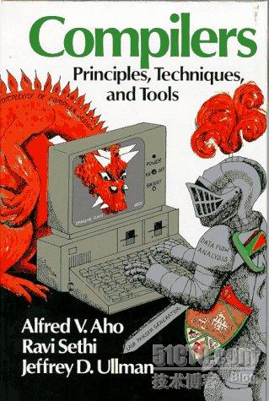
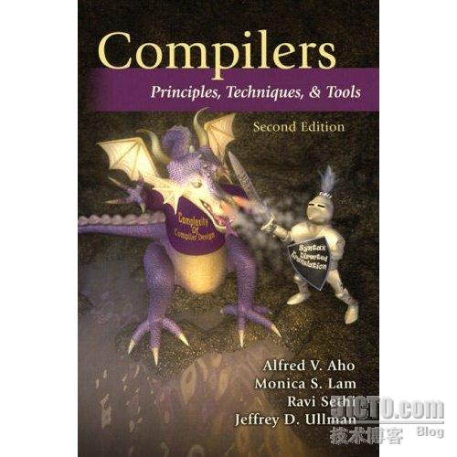

Slide 5
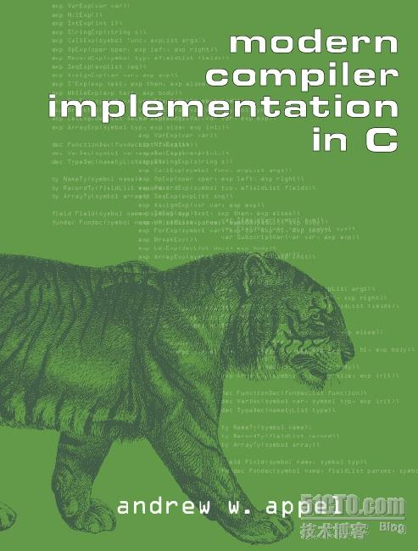
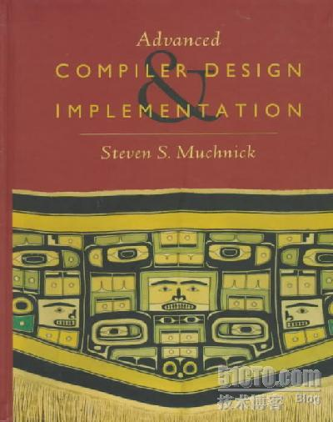

Slide 6


Slide 7
The role of a compiler in a system
DBMS
OS Shell
OS Kernel
Kernel
A Compiler
Application Programs

Slide 8
Why to arrange the course of compilers？
1、 Seeing the development of a compiler gives you a feeling for how programs work. That can help you understand the internal process of program execution deeply

Slide 9
Why to arrange the course of compilers？
2、Many algorithms and models you will use in compilers are fundamental, and will be useful to you elsewhere:
  automata, regular expressions (lex’ing)
  context-free grammars, trees (parsing)
  hash tables (symbol table)
  dynamic programming

Slide 10
Why to arrange the course of compilers？
  dynamic programming
    Characterize the structure of an optimal solution.
    Recursively define the value of an optimal solution.
    Compute the value of an optimal solution in a bottom-up fashion.
    Construct an optimal solution from computed information.

Slide 11
Why to arrange the course of compilers？
3、To program more efficient programs
Notes: Compiler writing spans programming languages, machine architecture, language theory, algorithms, and software engineering.
And the ideas behind principles and techniques of a compiler writing can be used many times in the career of a computer scientist.

Slide 12

Why to arrange the course of compilers？
4、

Slide 13
How to teach the course of compilers？
Syntax
Program
Language
Semantics
Pragmatics
High Level
Human
Language
Translating
Compiling
Inverse compiling
Assembling
Machine
Machine
Translating：Oral Translating Compiling：Written Translating

Slide 14
How a program to be processed and run?
Lexical & Syntax Analysis
Source Code
Corrected Code
Syntax-directed Translation
Intermediated Code
Optimization
Target Code Generation
Assembling Code
Optimized Code
Assembler
Binary Code
Executable Code
OS
Linking
DLL

Slide 15
The objective of the course
To provide knowledge of paring techniques.
To provide knowledge of error detection and recovery using different parsing techniques.
To provide concepts in semantic and syntax analysis of a programming language.
To provide concepts in intermediate code generation and optimization.

Slide 16
Framework of The Course
1、Introduction to compiling
2、Programming Language and Grammar Definition
3、Lexical Analysis
Theoretical Model: Regular Grammar and Finite Automation
Implementation: Lexical Analysis Program
Tools : LEX
4、Syntax Analysis
Theoretical Model：Context-free Grammar and Push-down Automation, LL(1) Grammar,LR Grammar
Implementation: Recursive descent parsing
Operator-precedence parsing
LR parsing
Using ambiguous grammars
Tools: YACC

Slide 17
Framework of The Course
5、Intermediate Code Generation and Syntax-directed Translation
6、Type Checking and Run-Time Environment
7、Code Optimization: Block Optimization, Loop Optimization, Global Optimization
8、Target Code generation

Slide 18
How to learn the course?
1、Focus on understand the principles deeply
2、Notice the relations among the chapters
3、Do more exercises , more practices and combine the theory with the labs

Slide 19
How to evaluate?
1、Exercises – 10%
2、Experiments – 20% (Total 2 experiments)
3、Term examination –70%

Slide 20
Chapter 1 Introduction to Compiling
1、What is a compiler?
very general definition: It is a piece of software that translates a program in one (artificial) language, Lang1, to a program in another (artificial) language, Lang2.
narrower definition: Our primarily focus is the case where Lang1 is a programming language that humans like to program in, and Lang2 is (or is “closer to”) a machine language, that a computer “understands” and can execute.
extra stipulation: The compiler should say something even if the input is not a valid program of Lang1. Namely, it should give an error message explaining why the input is not a valid program.

Slide 21
Chapter 1 Introduction to Compiling
1、What is a compiler?
Source Program
Target Program
Compiler
Error Messages

Slide 22
Chapter 1 Introduction to Compiling
2、 Why avoid compilers & program in machine language?
  A good programming language allows us to think at a level of abstraction suitable for the problem domain we are interested in.
  A good programming language should also facilitate robust code development.

Slide 23
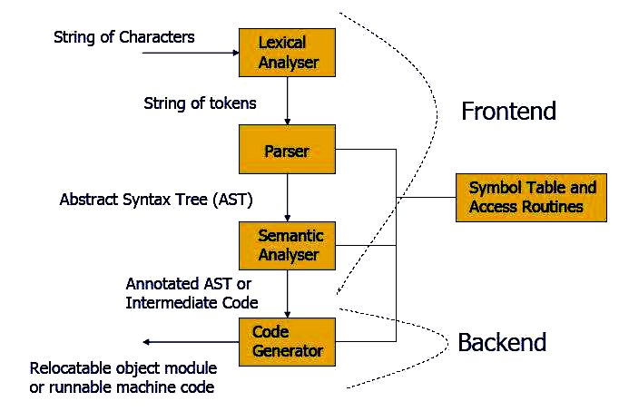
Chapter 1 Introduction to Compiling
3、Structure of a compiler

Slide 24
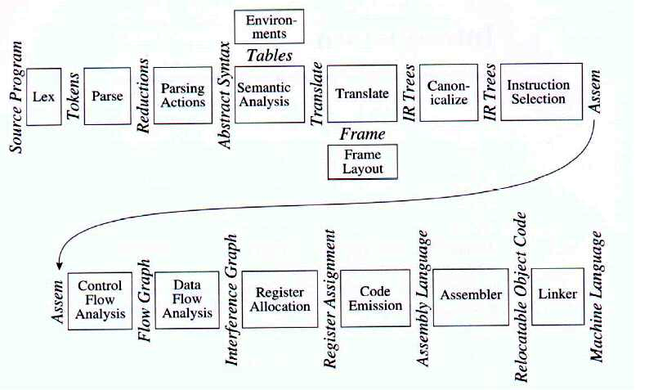
Chapter 1 Introduction to Compiling
4、More Structure of a compiler

Slide 25
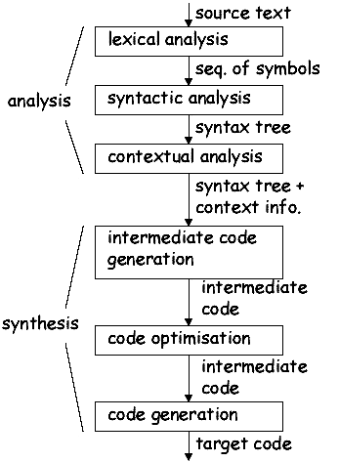
Chapter 1 Introduction to Compiling
2、The Analysis-Synthesis Model of Compilation
Linear analysis
Hierarchical analysis
Semantic analysis (type checking)

Slide 26
Chapter 1 Introduction to Compiling
2、The Analysis-Synthesis Model of Compilation
  Analysis part: Break up the source program into constitute pieces and create an intermediate representation of the source program
  Notes: One of ordinary intermediate representation methods is syntax tree /parse tree

Slide 27
Chapter 1 Introduction to Compiling
2、The Analysis-Synthesis Model of Compilation
  Syntax Tree/Parse tree: A hierarchical structure
Assignment statement
x=y+2*z
Parse Tree
Syntax Tree (is a compressed representation of parse tree)
=
=
exp
id
exp
x
+
exp
op
x
exp
op
exp
+
y
*
id
num
*
id
2
z
y
2
z

Slide 28
Chapter 1 Introduction to Compiling
2、The Analysis-Synthesis Model of Compilation
  Synthesis part: Construct the desired target program from the intermediate representation

Slide 29
Chapter 1 Introduction to Compiling
6、Symbol-Table Management
  Record the identifiers used in the source program and collect information about various attributes of each identifier, such as its type, its scope
  A symbol table is a data structure containing a record for each identifier, with fields for the attributes of the identifier

Slide 30

Chapter 1 Introduction to Compiling
6、Symbol-Table Management
  Shared by later phases
  Allow to find the record for each identifier quickly and to store or retrieve data from the table quickly

Slide 31
Chapter 1 Introduction to Compiling
7、Error Detection and Reporting
  The syntax and semantic analysis phases usually handle a large fraction of the errors detectable by the compiler

Slide 32
Chapter 1 Introduction to Compiling
3、How to construct a compiler?
  Program in a machine language for target machine directly
  Program in an assembling language
  Notes: The kernel of a compiler is usually programmed in an assembling language
  Program in high-level language
  Notes: This is an ordinary method

Slide 33
Chapter 1 Introduction to Compiling
3、How to construct a compiler?
  Self-Compiling
  Use compiler-construction tools
    Lex,Yacc
  Port among different platforms
  Notes: When constructing a compiler, a source language, a destination language and the compiling methods should be considered

Slide 34
Chapter 1 Introduction to Compiling
4、Compiler-Construction Tools
  Parser generators: Produce syntax analyzers, normally from input that is based on a context-free grammar
  Scanner generators: Automatically generate lexical analyzers, normally from a specification based on regular expression

Slide 35
Chapter 1 Introduction to Compiling
4、Compiler-Construction Tools
  Syntax-directed translation engine: Produce collections of routines that walk the parse tree, generating intermediate code
  Automatic code generators: Take a collection of rules that define the translation of each operation of the intermediate language into the machine language for the target machine

Slide 36
Chapter 1 Introduction to Compiling
4、Compiler-Construction Tools
  Data-flow engines

